Slide 1
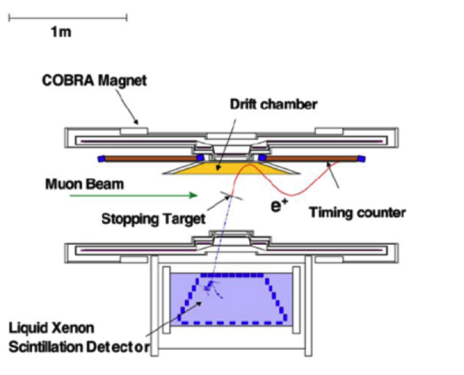
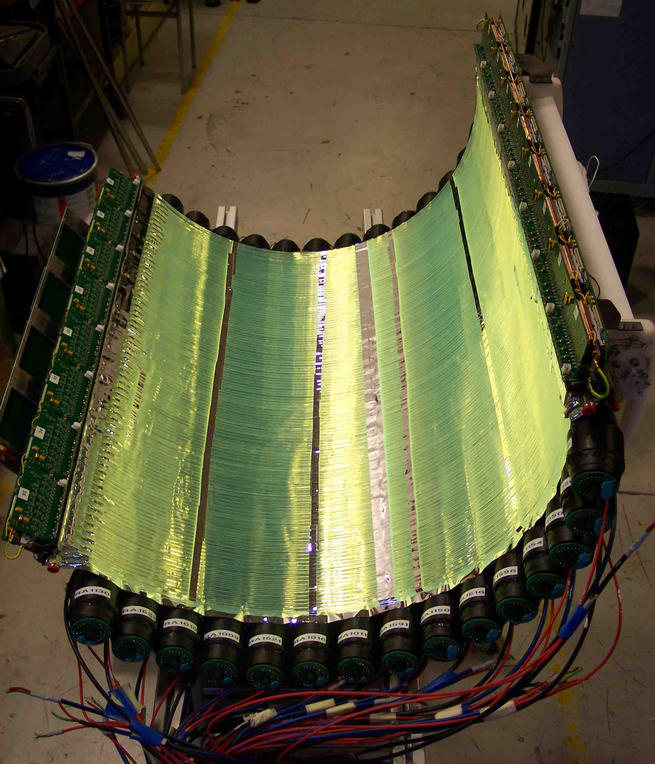
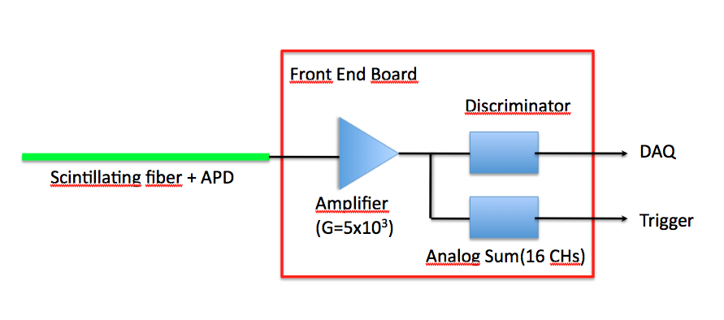
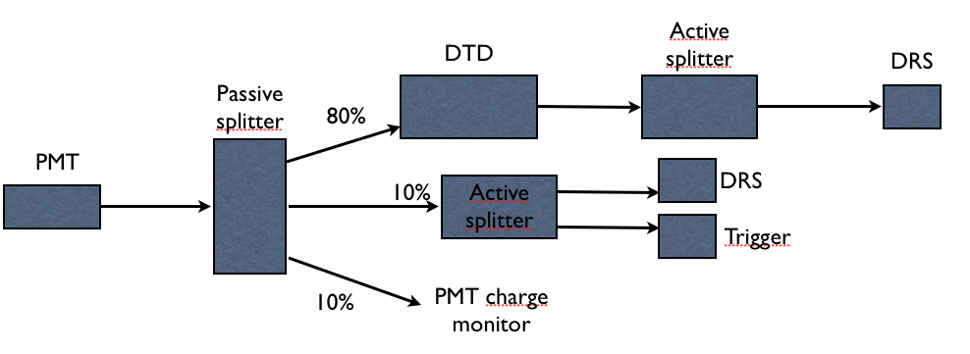
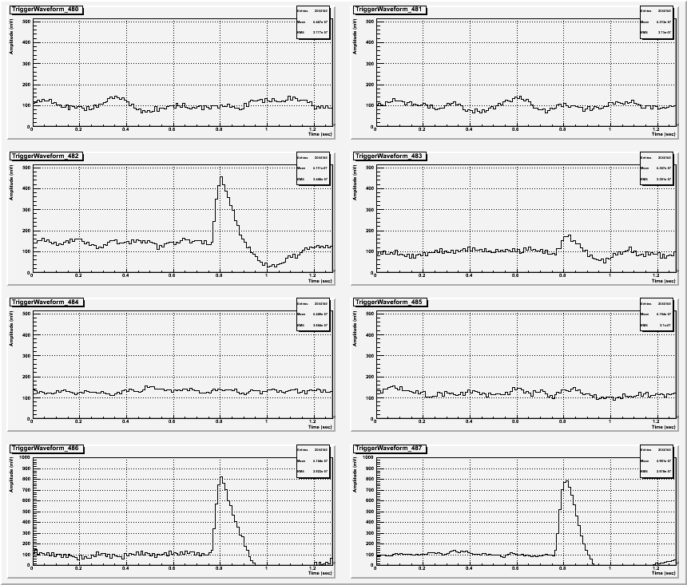
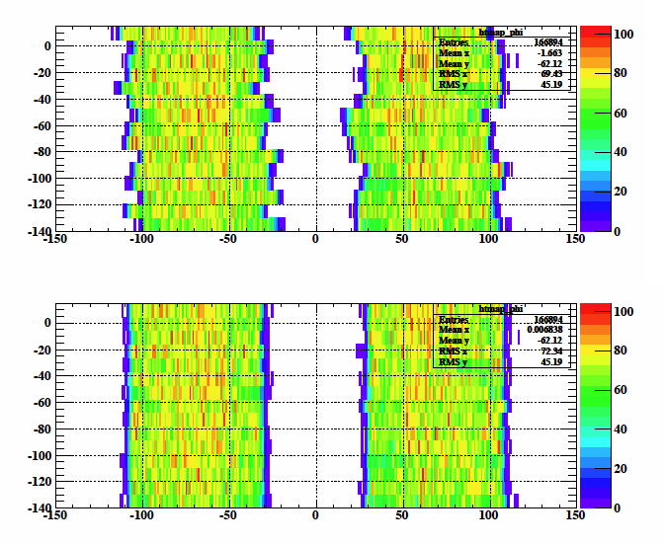
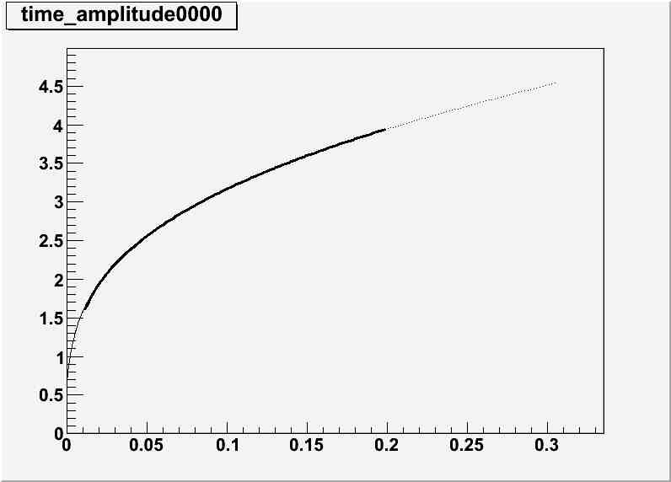
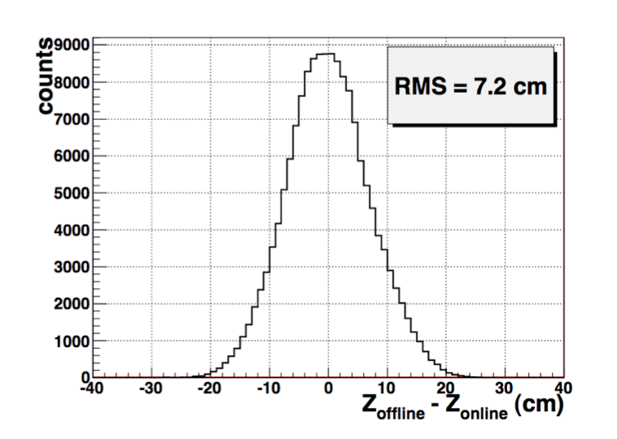
The Timing Counter of the Meg Experiment:
design and commissioning
M. De Gerone*
on behalf of the MEG Timing Counter Group
*INFN & University of Genoa
The Timing Counter of the MEG experiment is designed to deliver trigger information and to accurately measure the time of flight of the e⁺ to search for the rare decay μ→e+γ. It consists of two sectors located up and downstream the decay target. Each sector is made of two layers: scintillating fibers read by APDs for trigger and track reconstruction in the inner side, scintillating bars with PMTs readout for trigger and time measurement in the outer one. Here the design criteria , the calibrations and the performances of the detector reached during two years of run are presented.
MEG Experiment: sensitive search for μ→e+γ branching ratio.
Clear signature of the event: photon and positron with same energy (equal to half the muon mass) simultaneously detected back-to-back.
The TC must provide a fast and efficient trigger signal, togheter with a precise measurement of positron timing and impact point.
The detector is split in 2 identical modules, places simmetrically respect to the target to maximize geometrical acceptance. Each module is divided in 2 sub-detectors arranged in 2 layers: the longitudinal (outer) one and the transverse (inner) one, satisfying different requirements.
Both sub-detectors are based on fast optical devices.
Top view of the MEG layout
The longitudinal detector is made by 15 scintillating bars (Bicron BC404) with dimensions 4x4x80cm³, read-out by a couple of fine mesh PMTs (2” Hamamatsu R5924), stacked in a barrel like shape.
The averaged time of PMTs provides a high resolution measurement of the impact time, while positron impact point is reconstructed using pmt charge ratio in online trigger algorithm and time difference (offline).
A Double Threshold Discriminator system (DTD) is used to optimize timing resolution and event selection avoiding efficiency loss. Low threshold is put just outside noise level to achieve best time resolution. Events from signal positrons are selected by putting a high threshold according to Landau spectrum (1 couple of threshold values for all PMTs, required PMT equalization).
The Transverse detector is made of an array of 256 scintillating fibers coupled to Avalanche PhotoDiodes (APD).
The small size of the fibers (5X5mm) results in good spatial resolution and perfectly match APD sensitive area.
Fiber light transmission is improved using a reflective coat.
APDs are biassed very close to the breakdown voltage to obtain order 10³ gains.
Frontend electronics is mounted on detector: signals from bunches of 16 adjacent fibers are sent to trigger system, single fibers signals are discriminated and provide offline hitmap reconstruction.
Picture of Timing Counter with fibers exposed
Trigger (online performances)
Event reconstruction (offline performances)
APD signals
A PMTs charge/amplitude equalization is necessary also to have a reliable z estimation at trigger level by using charge ratio. The equalization is achieved using cosmic rays hitting the center of the bars and tuning gains to obtain almost equal (~10%) Landau’s peaks. Further refining made online at trigger level.
Inter bars offsets due to electronic chain are to be taken into account by aligning the cosmic rays distribution on TC.
Effective velocity for each bar is extrapolated from impact point distribution and reconstructed bar lenght.
Having the analog pulses acquired at 1.6Gs/s we can obtain the mean shape of each PMT waveform (template): the Time Walk is evaluated fitting the t(V) shape in the region of interest (i.e. for signal greater than high level threshold) with the function
where x is a normalized amplitude.
For each PMT an event-by-event correction is applied using the analog signal information and the calculated fit coefficients.
APD signals for a typical MEG event (in this case, we have 2 bunches of 16 APDs hit)…
…and corresponding offline Z reconstruction (Z_{bar}-Z_{APD})
Time [ns]
The trigger resolution is evaluated comparing the online reconstructed impact point with the offline one. We obtain 7,3 cm r.m.s. as showed in the picture.
Cosmic rays hitmap as seen on TC, before and after the allignment
Normalized Amplitude
Time vs normalized amplitude plot with fit superimposed
Final performances
Z resolutions are calculated using triple bars events, evaluating the distributions of
We obtain σ_{z} ~ 1.2cm.
Time resolution upper limit is extrapolated from multiple bar hit: time differences distributions for adjacent bars in double and triple bars coincidences from MEG data have sigmas in the range 60-90 ps.
The uniformity of the detector is quite good, every bars show resolutions
σ_{t} < 80ps for triple bars event.
High threshold studies: scan for HLT value to obtain efficient event selection.

